Slide 2

Modernizando las fábricas con Azure IoT hacia el concepto de Factorías 4.0
Javier Menéndez Pallo
Director de Madrid – ENCAMINA
@javierpallo
Alberto Diaz Martin
Head of Innovation - ENCAMINA
@adiazcan

Slide 4


Javier Menéndez Pallo
Director de ENCAMINA Madrid, Doctor en Investigación (PhD), apasionado de la tecnología y del buen rollo
Alberto Diaz Martin
Head of Innovation en ENCAMINA, geek and developer. Microsoft MVP en Office Servers and Systems

Slide 5
IIoT

Slide 6
Defining Internet of Things
Things
Connectivity
Data
Analytics

Slide 7
IoT Integration Patterns
Telemetry
The information flows from one device to another system notifying state and environment device
Inquiries
Requirements for devices seeking information or asking commence actions
Commands
Commands sent from other systems to a device or a group of devices to execute certain activity
Notifications
Information flowing from other systems into a loading device

Slide 8





Industrial Internet of Things
Things
Connectivity
Big Data
Analytics
Enterprise Security
Brilliant Machines
Access anytime/anywhere
Asset Management

Slide 9
Devices

Slide 10
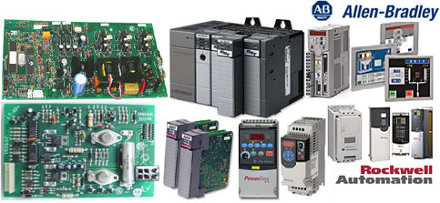
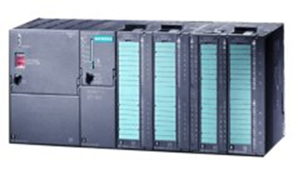
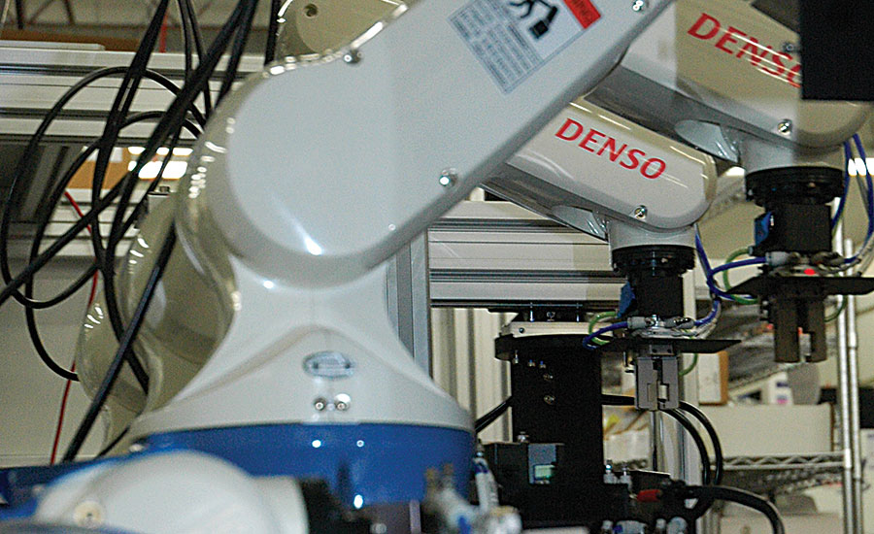
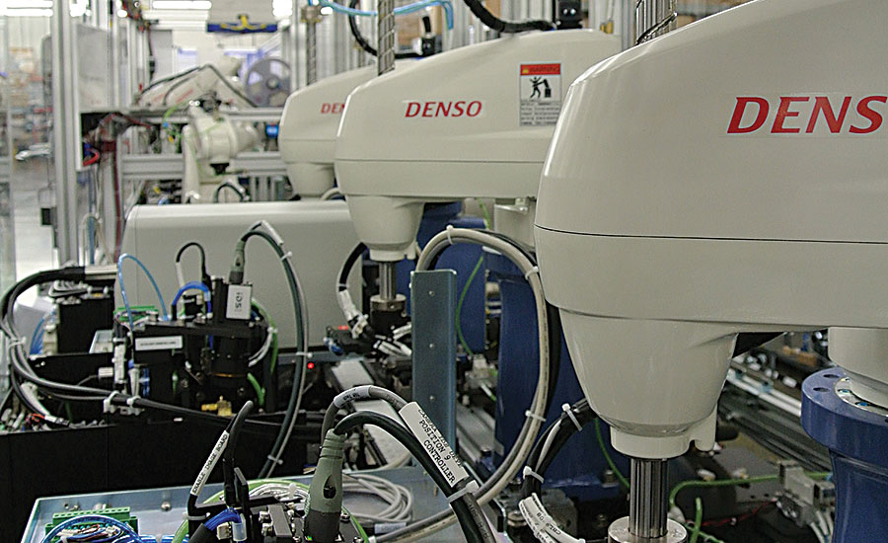
Devices
PLC – Legacy IoT
PLC – Legacy IoT
PLC – Legacy IoT
Denso – IP devices

Slide 11


Device Gateways
Sensors
Actuators
Mobile
Field Gateways
Device Gateway
Topics
Queues
Storage
Event Hubs
Telemetry
Reporting
Integration
Compute
Command & Control
NRT
HDInsight

Slide 12
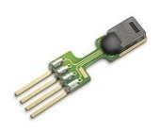
Device Gateways components
Existing IP Based Protocols
Scaled Communication Infrastructure
(Device Gateway + Azure Service Bus)
Existing Systems
SCADA
Device Registry
MultiSpeak
MQTT
Service Bus
Command Gateway
Custom Protocol Gateway
Mobus
AMQP
Telemetry Pump
CoAP
OPC UA

Slide 13
Protocols and connectivity
AMQP (Advanced Message Queuing Protocol)
MQTT (MQ Telemetry Transport)
CoAP (Constrained Application Protocol)
OMA LWM2M (OMA Lightweight M2M)
XMPP (Extensible Messaging & Presence Protocol)

Slide 14
Azure IoT

Slide 15

Microsoft Azure IoT Suite
Device Connectivity & Management
Data Ingestion and Command & Control
Stream Processing & Predictive Analytics
Workflow Automation
Dashboards and Visualization
Preconfigured Solutions
visit www.InternetofYourThings.com

Slide 16














Azure IoT Services
Devices | Device Connectivity | Storage | Analytics | Presentation & Action
 | Event Hub | SQL Database | Machine Learning | App Service
 |  | Table/Blob Storage | Stream Analytics | Power BI
 |  | DocumentDB | HDInsight | Notification Hubs
 |  | 3rd party Databases | Data Factory | Mobile Services
 |  |  | Data Lake | BizTalk Services
{ }

Slide 17
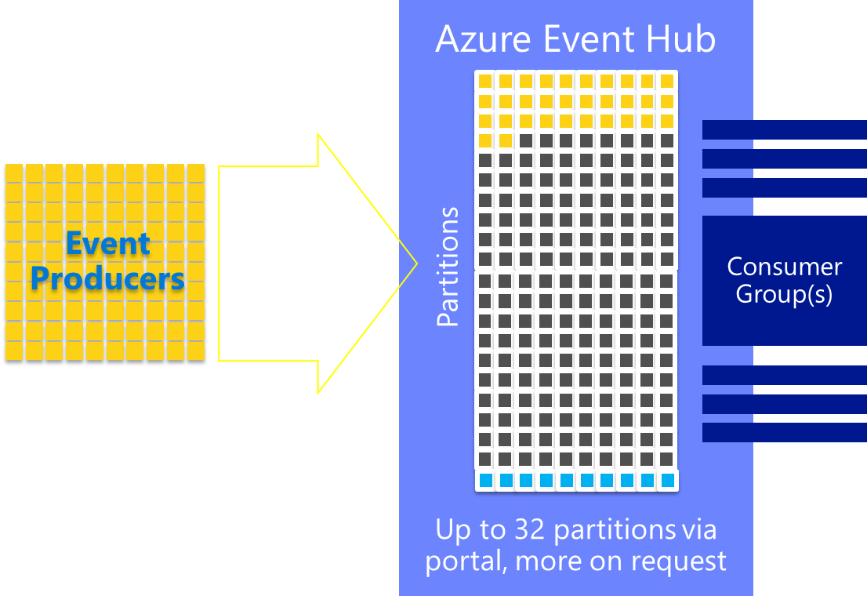
Azure Event Hubs
A scalable service for ingesting data from line-of-business assets and sensors.
Stream millions of events per second with elastic scale.
Security ensured via Shared Access Signature (SAS) tokens to authenticate clients.

Slide 18
Azure Stream Analytics
A distributed stream computation service that integrates with Event Hubs to provide low latency, real-time processing of millions of events per second.
Data at Rest vs. Data in Motion
Write queries in SQL with familiar operators and functions to filter and join static and streaming data.

Slide 19
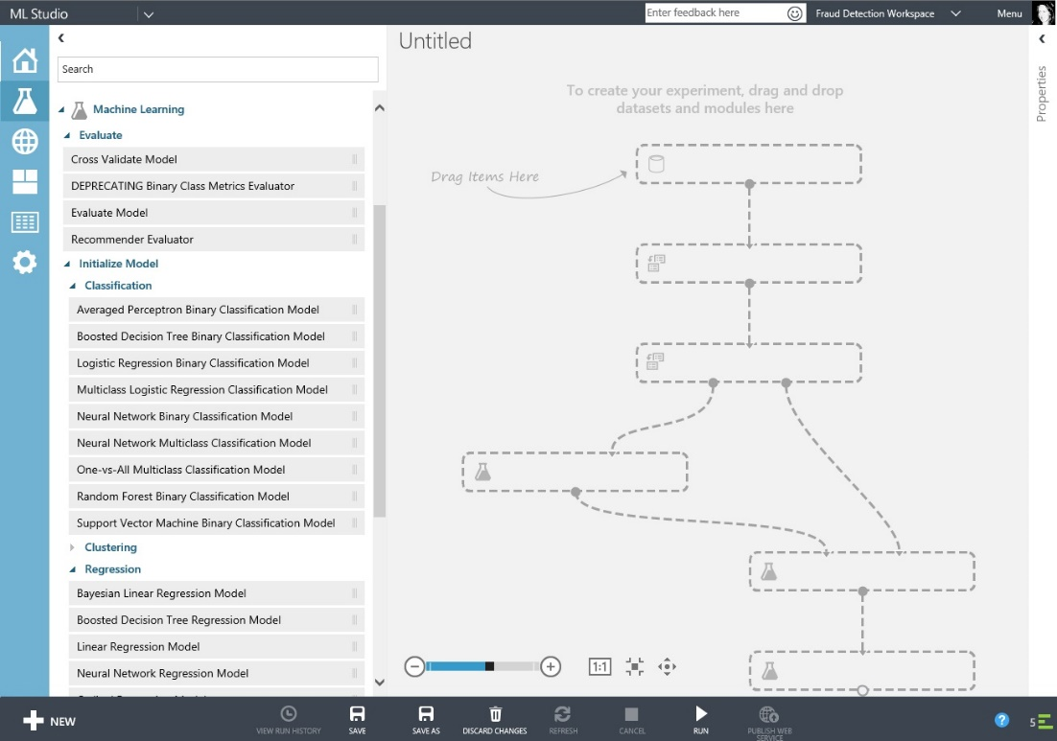
Azure Machine Learning
Harness machine-generated data with powerful, cloud-based predictive analytics.
Machine Learning Studio is a drag and drop visual environment allowing you to build, test and deploy solutions that operate on telemetry.

Slide 20




Machine Learning Patterns
Reactive
Preventive
Predictive

Slide 21
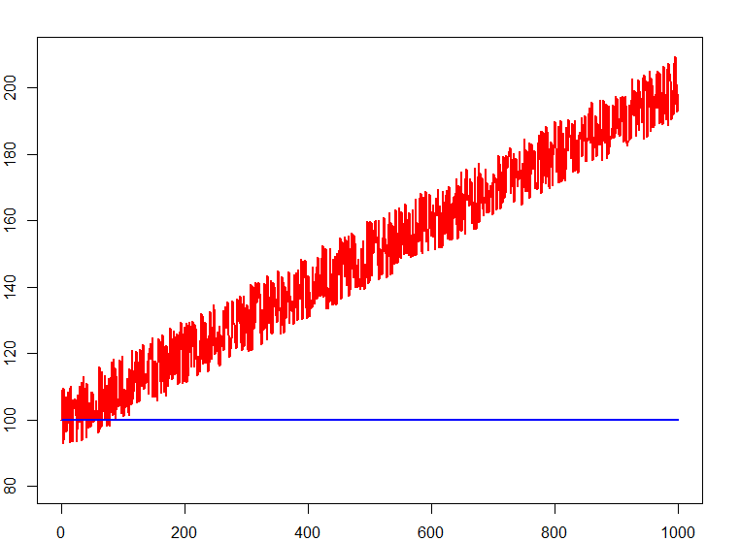
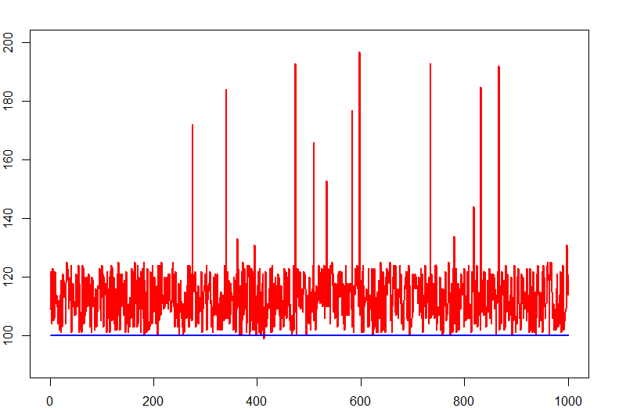
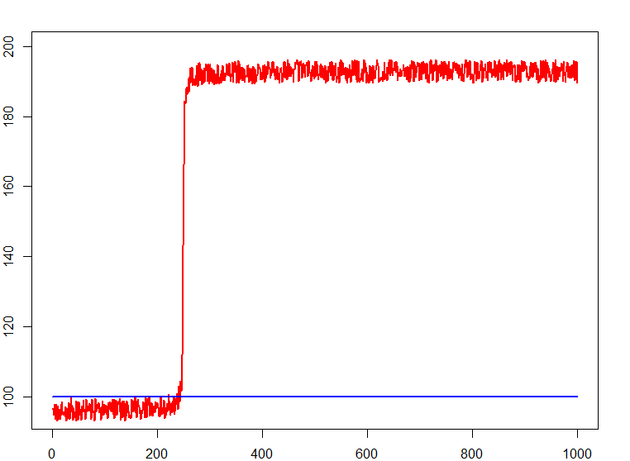
Machine Learning Use of cases
Degradation
Deviations
Step
Increase in energy consumption → lubrication system fault
Number of error messages is unexpectedly and abnormally high → Light sensor with loose contact
Sudden increase in energy consumption
→ loss in the compressed air system

Slide 22
DENIoT 4.0

Slide 23
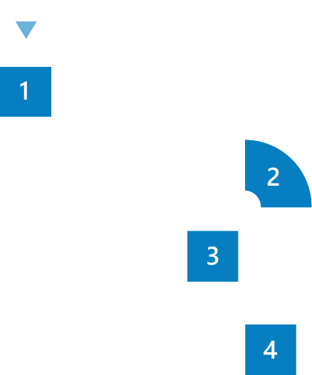





What’s the Industry 4.0?
Industry 1.0
- Start of the 18th Century
Mechanical production facilities powered by water and steam
Industry 2.0
- Start of the 20th Century
Mass production powered by electrical energy
Industry 3.0
- Start of the 70ies
Introduction of electronics, IT and automation
Industry 4.0
- Today
Smart factories: ciber-physical systems, integration, efficiency and adaptation to the needs

Slide 24



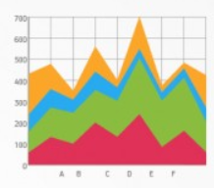





What’s the Industry 4.0?
Smart factories
IIoT (Industrial Internet of the Things)
Communication between systems
Monitoring and Prediction
Willingness to buy
Adaptation of the factories to the needs of the market

Slide 25







DENIoT Concept
Industrial Robots
DENIoT
Integration with various devices that we are in the industry
High performance data processing
Analysis and Machine Learning

Slide 26
DENIoT Architecture
Azure elements
IoT Hub
Service Bus
Stream Analytics
Service Bus Queue
Storage blob
DocumentDB
SQL Database
Web App
Logic App
Machine Learning
HDInsight
Notification Hubs
Azure Active Directory

Slide 27
DEMO

Slide 29
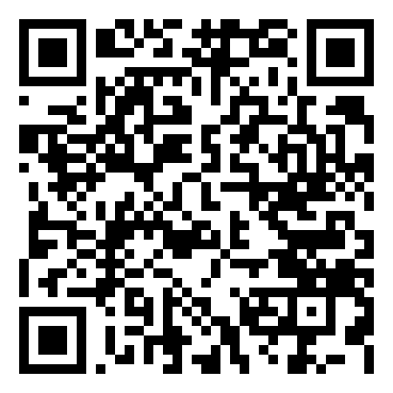
Javier Menéndez Pallo
Director de Madrid – ENCAMINA
@javierpallo
Alberto Diaz Martin
Head of Innovation - ENCAMINA
@adiazcan
http://aka.ms/DOTNETT8S3

Slide 30

Getting Started
Start with business plan
Get executive buy in
Leverage Quick Start consultation
Start your Azure IoT Experience at
www.InternetOfYourThings.com

